Slide 1
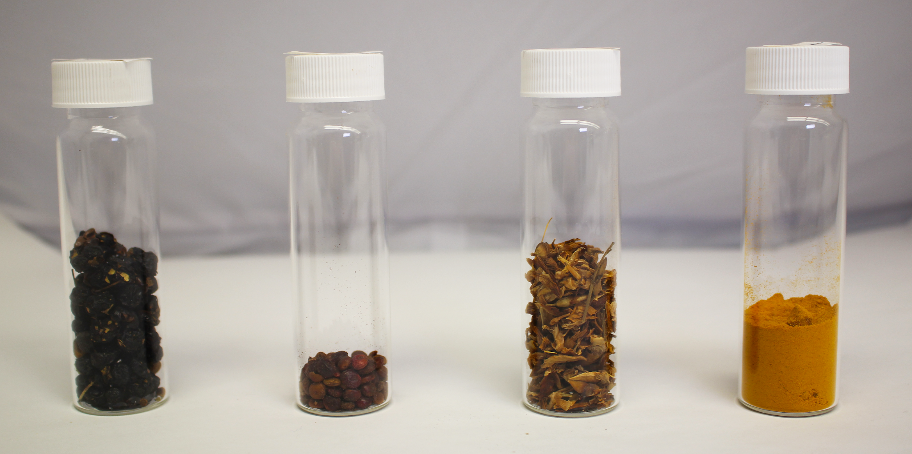
Buckthorn berries (ripe)
Sumac
Dyer’s broom
Turmeric

Slide 2
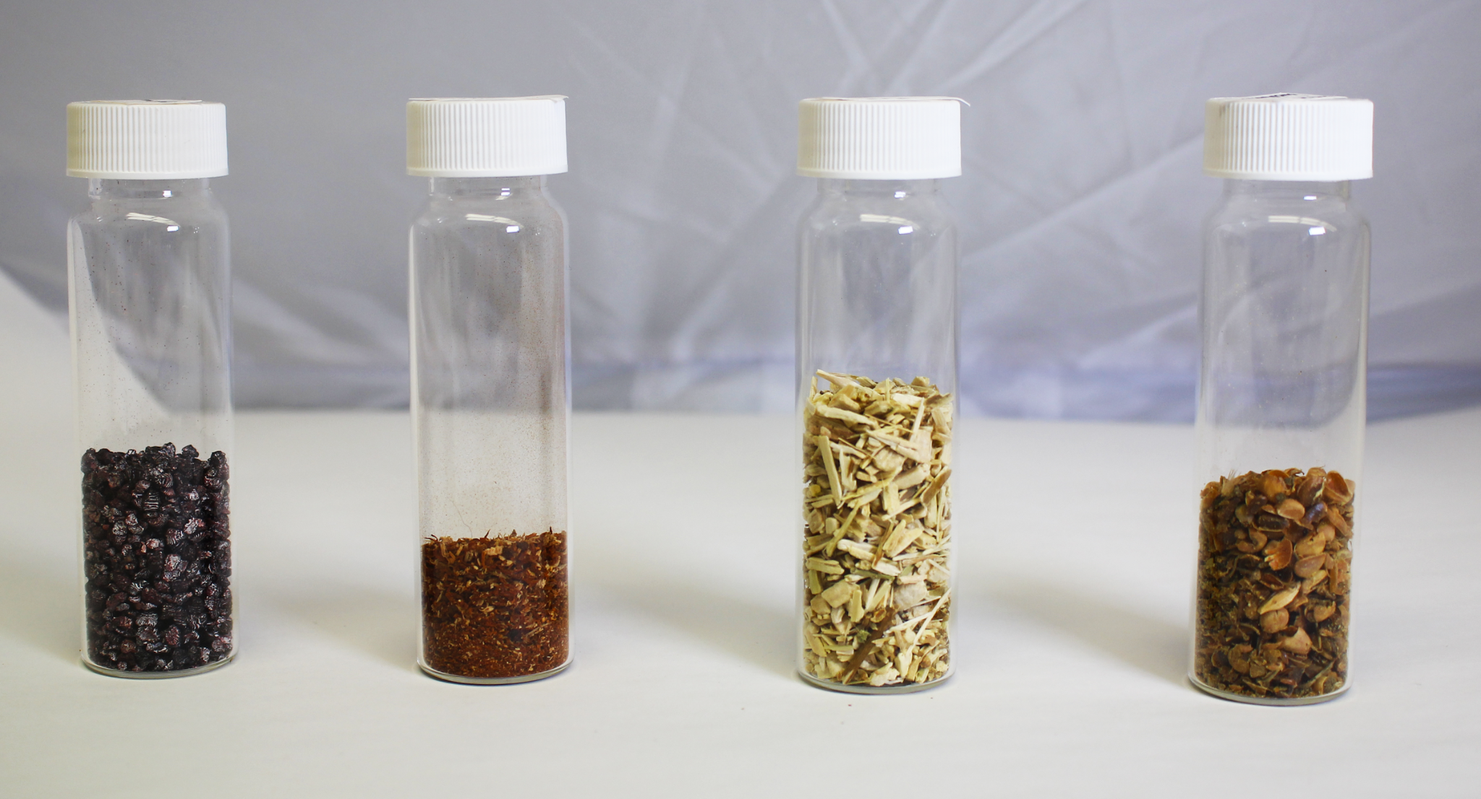
Cochineal
Brazilwood
Weld
Buckthorn berries (unripe)

Slide 3
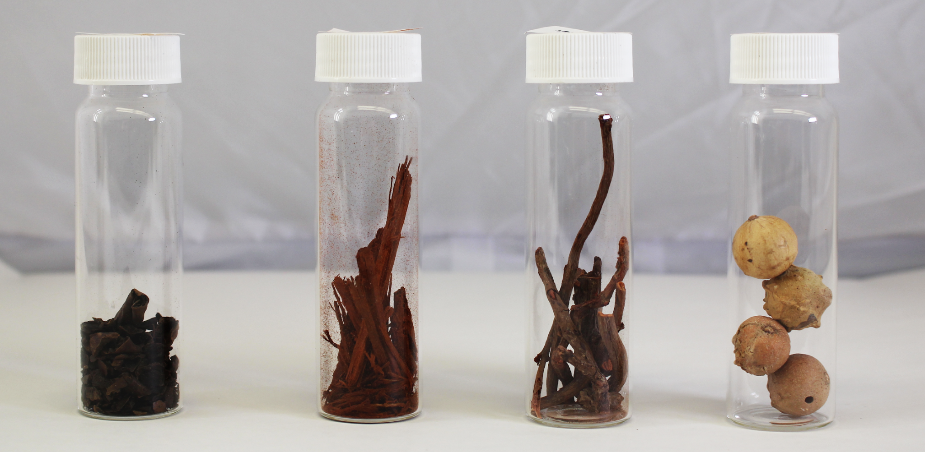
Black walnut
Logwood
Madder
Gallnuts

Slide 4
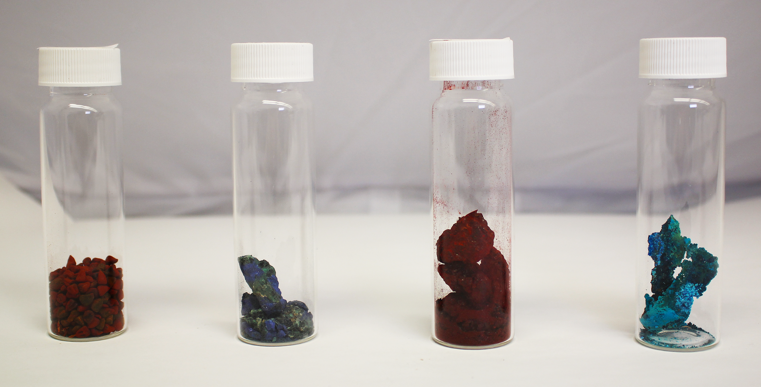
Annatto (achiote)
Azurite
Dragon’s blood
Verdigris

Slide 5
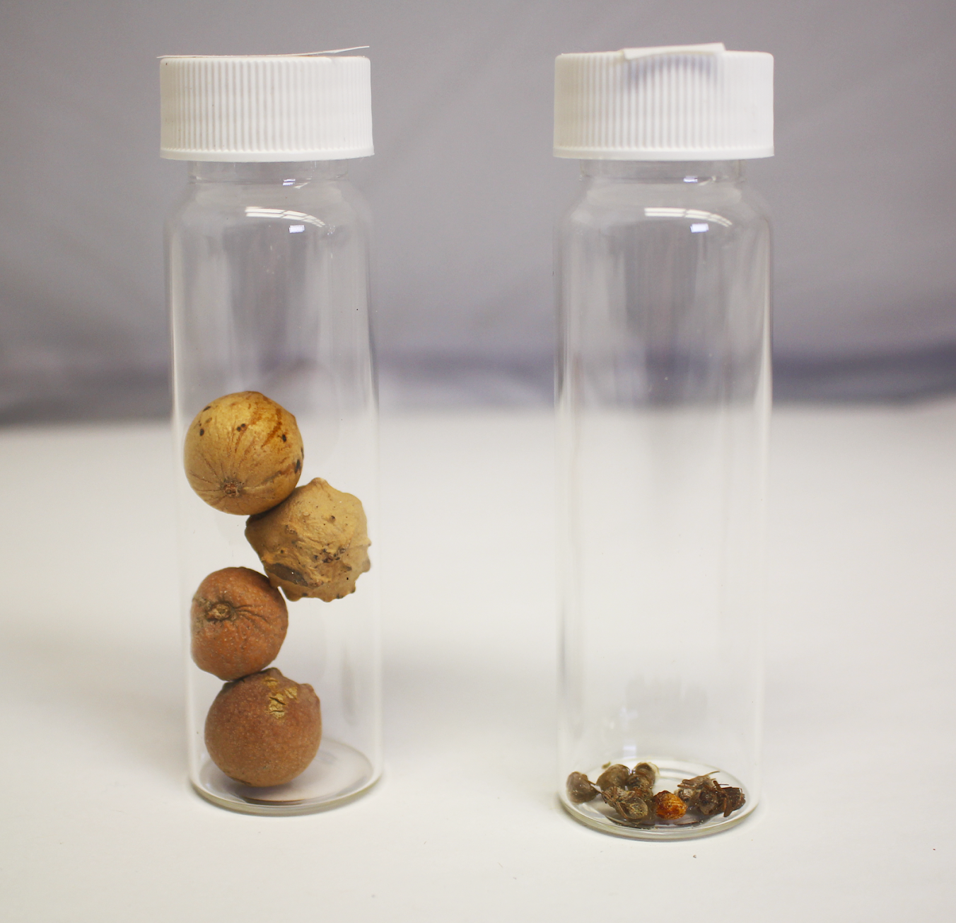
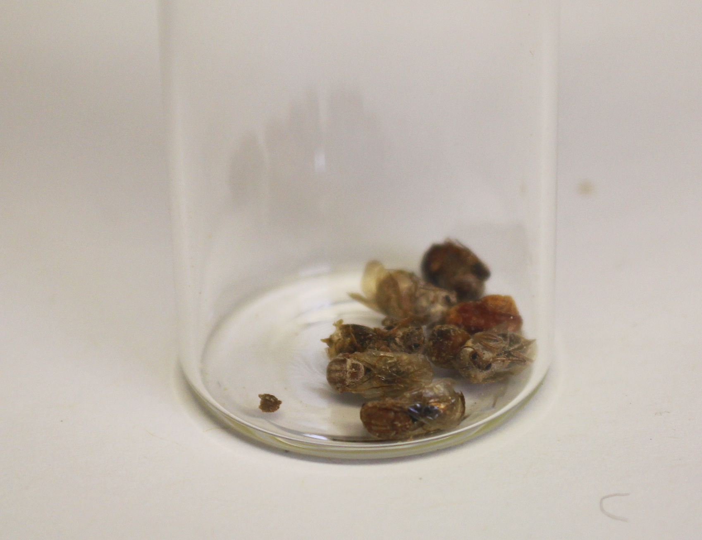
Gall nuts
Gall wasps
Gall wasps

