Slide 1
Foraging for Pigments
A Making and Knowing Project
by Vivian Mellon Snyder
Summer 2021, HIST GU4962

Slide 2
About the Project
I’ve been painting for about six years now; it’s surprising to me that, after all this time, I haven’t done much to explore the science and craft behind the material I rely on most: pigment. The way I’ve understood the “life” of paint had begun when I bought it from little metal tubes, and ended when that paint dried on canvas.
My involvement with the Making and Knowing Project brought me to wonder about the origins of pigments which I use in my own art practice. As it turns out, most of them are synthetic: these pigments hold fast against light, blend with each other like a dream, and are relatively affordable. Still, there’s so much about natural pigment which intrigues me: whether through the geological processes of millenia, or biological happenchance, our natural world is filled with color! For the last few weeks, I’ve been exploring just a few natural sources of color, attempting (and often failing) to transform this color into pigment, and combining it with oil to create oil paint.

Slide 3
Sourcing Information
The most difficult part of this whole process was the search for detailed information.
Reading historical manuscripts like Ms. Fr. 640, you can catch a glimpse of how craftspeople would have thought about pigment and paint pre-little-metal-tube era. There are hints about the process of foraging for materials, but perhaps because its author was dedicated to a whole range of craft (taxidermy, casting, cooking, and medicine, to name a few), many fundamental instructions are left out, and some (for my efforts, at least) superfluous instructions left in.
Here are some excerpts, to give you an idea of the type of information available to me:

Slide 4
Foraging for materials
Ms. Fr. 640, fol. 90r, contains a statement about how artisans seek materials (in this case, for mold-making) in nature:
“Artisans who work in large works & who need to further their profit by seeking things already prepared in nature, because she does not sell her wares to her children, and to also save the time they would use for grinding finely & for artificially preparing sands, seek the one of the mines, which is not too fatty, the one that is a kin of earth, not too lean & consequently without bond, but rather that which is pulled from the depths of the sand-bed in bricks & clods that show its natural compaction, which is quite difficult to break & which has a very small & delicate grain, & which is found soft when handling it between the fingers. And because the latter is only found near the rocks in mountainous areas or lean territories, & akin to the arene, it cannot be found in in the surroundings of all the bonnes villes where artisans willingly gather. And thus, if they do not have it close to their house, they prefer to have it come from afar, like from Lyon, Venice, Paris near the Sainct Chappelle & similar places, rather than prepare it. However, you can be certain that in all places you can render the sand from a mine good & proper for molding…”

Slide 5
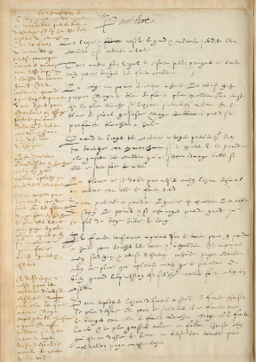
Observations on colors from Ms. Fr. 640 (fol. 56v)
Chalk has no body in oil. Ceruse is appropriate. But lead white more excellent. Ceruse is the whitest, when ground first in water, the lead white grayish. But it takes on its perfect whiteness in oil.
When you grind your colors, first clean your workshop well, for when walking, if you stir up dust, this will damage your colors, which will never be beautiful if they are not very clean.
Florey must not be mixed with azur d’esmail or another, for it makes it green.
For palettes to paint, ivory is excellent, knots of the fir tree, the pear tree, & if it is a walnut tree, make sure the grain of the wood runs lengthwise.
One always needs to apply imprimatura on wood to paint there in oil in order to fill the holes & unevenness, and make imprimatura with some stil de grain yellow & ceruse tempered in oil, then soften with a feather, which flattens better than a paintbrush. Or when the imprimatura is dry, scrape strongly with a knife.
To use azur d’esmail in oil, one needs to choose the most delicate. And to render it subtle, one ought not to grind it, for this makes it whiten. But one needs to wash it, & the coarsest going to the bottom, choose the one that is above in the water or, by inclination, pour out the cloudy water, then gather the azure.

Slide 6
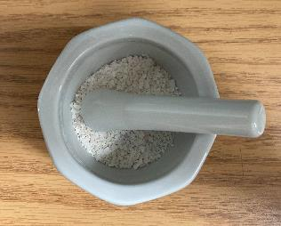
Sourcing Information
I found that the manuscript was not especially helpful to my very elementary process of sourcing and extracting pigments. However there is a great deal of information here, that I understood better after I had already begun to experiment. The line “Chalk has no body in oil.” didn’t mean much to me at the beginning of my process, but I actually did end up running into this very issue. At one point, unable to find soft, white stones to create a white pigment, I tried to grind up eggshells. After my mortar and pestle helped me get these into a fine powder, I tried incorporating linseed oil. Unfortunately, this just made a grainy mess. As it turns out, eggshells are the same (chemically speaking) as chalk: they’re both calcium carbonate. I will say that there is something reassuring about someone hundreds of years ago trying, and failing, at the same experiment as you.
Thankfully, I got a solid introduction to some pigment making basics in class. We used cochineal, alum, and potash to create a stable, water insoluble pigment from the beautiful pink color the cochineal released when boiled. This process was essentially the backbone of most organic pigment extraction processes that I carried out.

Slide 7
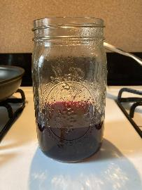
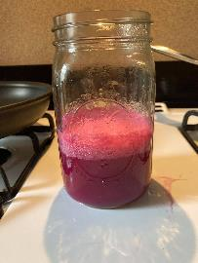
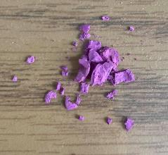
Cochineal Pigment Extraction
You can see the abbreviated process here. First, the colorant from cochineal was extracted into water by boiling it in alum. Adding potash in small increments allowed the pigment to become insoluble, and separate itself from the water. After being filtered and dried out, I was left with a powder that I could combine with various painting mediums.
Beyond being so excited to have made my first organic pigment, I was suddenly overwhelmed by possibilities of color. Blueberries, cherries, carrots, beets, lemons, all have a wonderful color, and I can get them from the grocery store just blocks away. But would these make pigments, too?

Slide 8
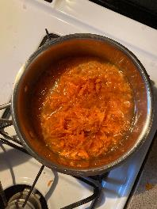
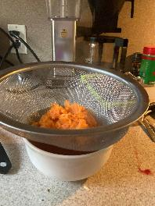
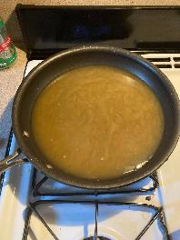
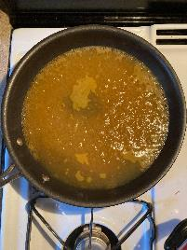
Carrot Pigment
Carrot pigment extraction was my second failure, after the eggshell white experiment. Carrots have a lovely color, and so I thought that I could surely create a stable, insoluble pigment from them. Here is my process:
1. Shave and boil carrots
2. Strain carrot pulp away
3. Evaporate off excess water
4. Add about 1 tablespoon of alum

Slide 9
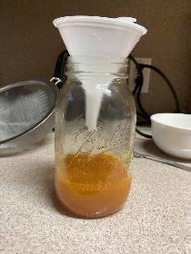
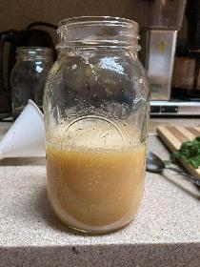
Carrot Pigment
I gave the mixture time to precipitate after this final step. However, I didn’t notice any precipitation at all. I filtered this solution using a coffee filter and funnel, and waited until the “pigment” was captured in the filter. I noticed it was a pale, peachy color quite unlike the orange I hoped to achieve. Another strange thing was the texture-- it was very, very slimy looking. Even several days later, it was quite soft and gooey, and hadn’t dried completely. Weeks later, a stiff goop is left, and I don’t think there’s any way of salvaging it.
5. Strain away finer particles of carrot with coffee filter
6. Add potash, and wait for the pigment to separate from water

Slide 10
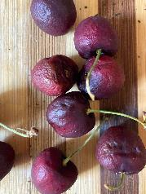
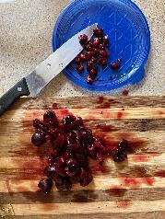
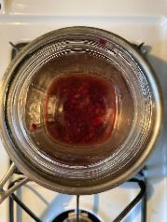
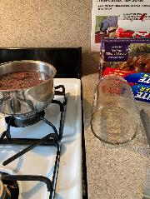
Cherry Pigment
Cherry pigment extraction taught me more about safety protocols than anything else. I ended up with an exploded mason jar, a huge mess, and a shattered heart. I held off on trying the process again since I used all of my cherries, and wanted to move on to other sources of pigment.
This said, never put even “shatter proof” canning jars directly into boiling water! They need to adjust to temperature changes gradually.
1. Selecting shriveled cherries that I don’t want to eat, perfect for “recycling!”
4. Broken jar from rapid heat changes: I needed a moment to emotionally recover
2. Removing pits
3. Boiling to extract color

Slide 11
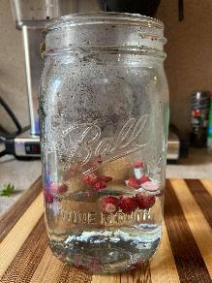
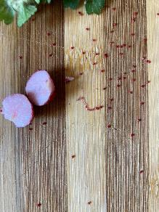
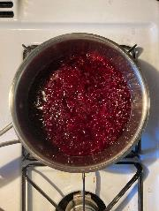
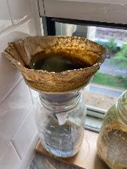
Wild Strawberry
Pigment
Beet Pigment
As an alternative to cherries, I gave beets a try. Beets also have a beautiful, vivid red color; as an added bonus, they stain clothes and even skin very easily! Because of this, I thought they would be a good candidate for making pigment. I carried out a process very similar to that I used for carrots: I shaved the beets, boiled them, strained out and filtered the pulp, alum, and then precipitated the colored water with potash. Unfortunately, the color of the beet water changed to a muddy, greenish brown after the potash was added. And, like the carrot precipitate, what was left in the filter was a goopy mess that didn’t dry into a fine powder.
I picked some wild strawberries from Riverside Park (NYC), which I thought could release some amount of color. Unfortunately, the bright red seeds on the outside of the strawberries were very tough and seedlike, and didn’t release color into the water no matter how long I boiled them. In the future, I might try separating these seeds and grinding them with a mortar and pestle. The yield is very small from each berry, though, and I didn’t want to disrupt the ecosystem of the park by picking enough to create even a small amount of paste.

Slide 12
Sourcing Information… Again
After five pigment-making failures (eggshells, carrot, cherries (to be fair, I didn’t manage to complete the process), wild strawberries, and beets), I felt that I needed more confidence that the materials could feasibly form pigment. Each of these processes is a pretty hefty time investment: it took more than an hour to grind up eggshells into a fine powder, the total carrot process (shaving, boiling, and precipitating) took more than two, and the cherry process (pitting and boiling) took 30 minutes without anything to show for it.
I ended up turning to Youtube to have a clearer idea of what could successfully yield pigment.

Slide 13
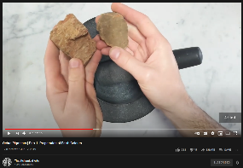
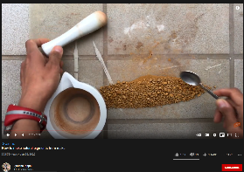
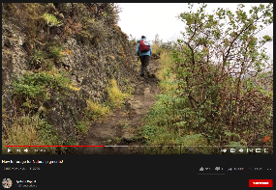
Learning from Others
As I mentioned, Youtube was a huge help for me. People have dedicated a lot of time to sharing what they’ve learned through similar processes as mine. These videos inspired me to give inorganic pigments a shot in the meantime, as I continued to research and refine my organic pigment extraction process. I compiled a list of all of my reference sources, which you can find at the end of this presentation. I really suggest watching these, especially if you learn better by watching than by reading, like me.

Slide 14
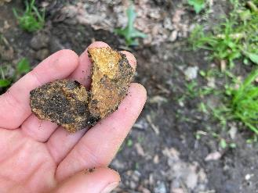
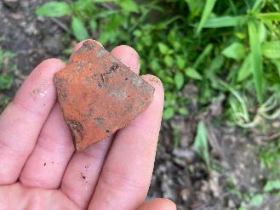
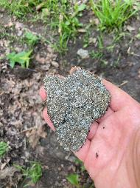
Organic vs. Inorganic Pigments
One thing to note is that, up until this point, I had only been working with organic pigments (i.e., colors extracted from plants--and, in cochineal’s case, insects). There was another avenue to explore: inorganic pigments. I found a lot of inspiration for this on Youtube, and while I wasn’t sure what minerals I’d have access to in NYC, I thought it would definitely be worth a shot. I walked through Riverside over the course of several days, and looked for any colored rocks I could find. Here are some pictures I took on my hunt:

Slide 15
Working with Inorganic Pigments
I ended up having a lot of success making inorganic pigments. The nice thing about the process is how consistent it is. It’s pretty easy to predict which minerals make the best pigment (they’re soft (I’d check by trying to scratch color onto harder rocks) and brightly colored). Most anything with color works, though, if you’re willing to take the time to grind it down!
Here’s the process, from beginning to end:
Pick out your materials (I ended up having success not only with soft minerals, but with glassy rocks and even bricks)
If the pieces are bigger than a quarter, break them down outside with a hammer. You’ll want goggles for this and later steps, to prevent shards from getting in your eyes.
Use a heavy stone mortar and pestle (mine is a large granite one) to grind down the material as fine as you can. It should feel like powder when you’re done. You can watch Netflix while you do this, because it will take a while.
Pour the powdered material into a glass or jar, and fill it up half way with water. Swirl the water to help the finer colored particles rise and the sand/silt/larger chunks to fall to the bottom.
Pour the colored water into a high-surface-area vessel (like a pan or wide bowl) and wait for the water to evaporate. Make sure that no silt falls into this container.
When the water evaporates, you’ll be left with a dust-fine pigment! You can mull this into oil to create paint. I set mine aside in small containers for later use.

Slide 16
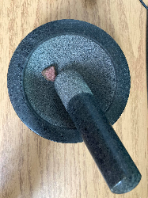
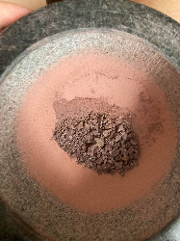
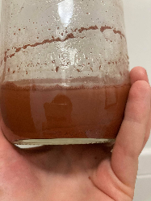
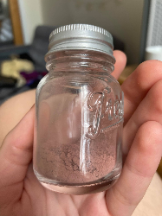
1. Start with quarter sized chunks
2. Grind these down as much as you can. I first use a crushing motion with the pestle to create fragments like these pictures. Then, I used a circular grinding motion to create a fine powder.
3. Next, pour the fine powder into a jar with a little water. You can really eyeball the amount of water, here. You want to see a clear separation between silt on the bottom and colored water on top.
4. Leave this colored water out in a container of your choice to evaporate, and when it dries, you’ll be left with pigment!
That’s the whole process! I repeated this with every brick/rock/mineral I used for this project, and it worked every single time. I’ll show the end result of the pigments I created using this process later on.

Slide 17
Organic Pigments: Take Two!
I learned a lot from watching others’ experiments, and a huge takeaway was that not all plants with bright colors will viably produce pigments. Some colors will oxidize and turn brown, some will be damaged by boiling, and some fade rapidly in light. This knowledge, at least, helped to narrow down my ever-expanding list of pigment experiments to:
Pomegranate (for this, I’d like to give a special thanks to the Youtube channel The Alchemical Arts. This was the only place I could find information about pomegranate pigment extraction, besides an article by a RISD student which had no pictures documenting the process)
Avocado
Madder
Red Onion

Slide 18
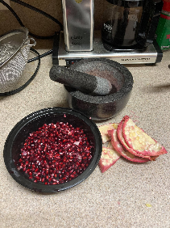
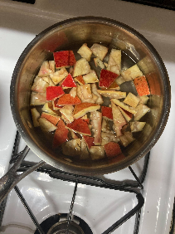
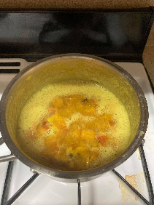
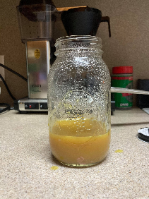
Pomegranate Lake
This was, by far, the most surprising outcome of my organic pigment experiments. Again, I’d like to emphasize my thanks for the Youtube Channel The Alchemical Arts for sharing their process; without it, I never would have thought that pomegranate skin (yes- the skin, not the seeds!) could yield a bright yellow pigment.
1. Separate pomegranate skin from the seeds and lining
3. Add about 2 tablespoon of alum (look how the color changed!)
2. Boil for about 30 minutes
4. Filter out the pulp with funnel and coffee filter

Slide 19
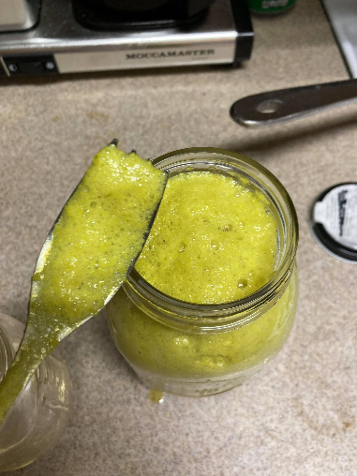
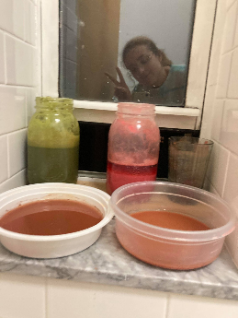
After adding alum to the colored water and incorporating in my potash/water solution, my mixture kept turning greener and greener. By the time I added enough potash for the bubbling to slow down, I was left with a neon green.
You can see the muddy green that I was eventually left with here. Unfortunately, the pigment never precipitated away from the water for some reason, so I decided to try again.
*my madder lake experiment is also here, but I’ll get to that later.

Slide 20
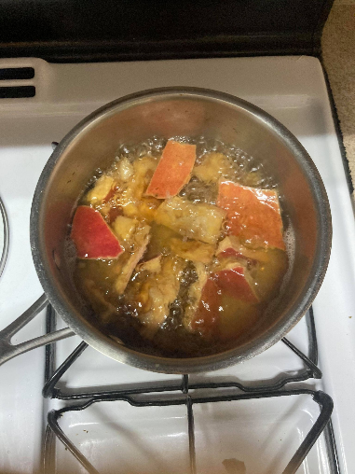
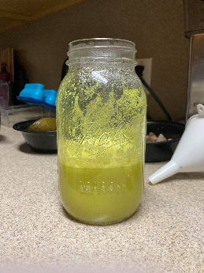
This time, I strained the pomegranate skins out sooner (I think that the last time I overcooked them, and released some pulp into the water that contributed to the green I saw- some kind of oxidation, perhaps?)
This was less green, and more yellow, than the last experiment. Fortunately, it did precipitate into a pigment! There wasn’t much yield, but I think that if I experiment further, I can produce a yellow pigment like I saw on Youtube.

Slide 21
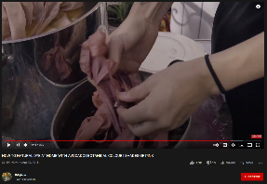
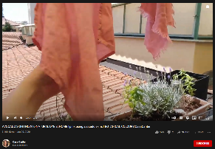
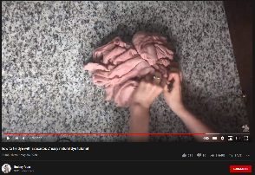
Avocado Lake
I found a handful of Youtubers who were able to dye fabric using avocado pits, peels, or pits and peels. I thought that if they could create a color-saturated water capable of dying fabric, then I might be able to translate their process to creating an avocado lake. Interestingly, they were able to create a mauvey pink from avocado!
Unfortunately, I wasn’t able to pull any pigment from avocado pits, peels, or a combination of the two. I used the same type of avocado as them (Hass), so I’m not sure why it didn’t work. I boiled at the same temperature and for the same amount of time as them. When that didn’t work, I tried upping the temperature and leaving it on the stove longer… to no avail.

Slide 22
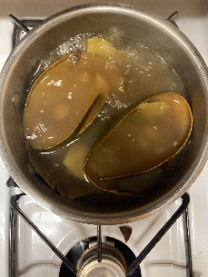
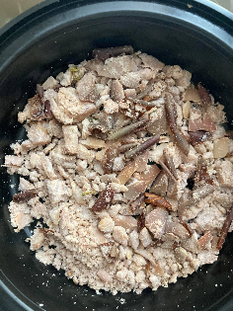
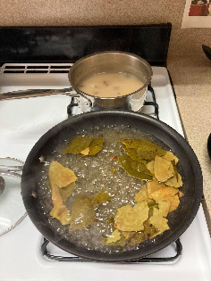
Avocado Lake
No matter what I did, I was left with some soft shade of brown. Here are some pictures of the processes I tried.
Boiling avocado skins and pits
Some avocado pits I ground up and left to oxidize overnight
Boiling avocado skins and pits separately

Slide 23
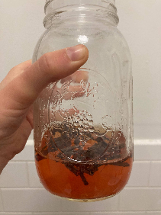
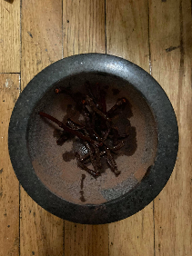
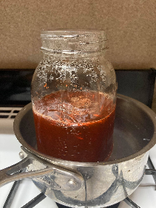
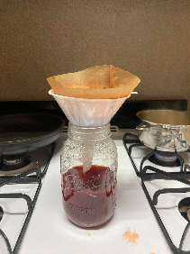
Madder Lake
I had a lot of success with madder. The process was essentially the same as with cochineal, only this time I had to start by “washing” the madder roots by soaking them for a few hours. I then crushed them up with a mortar and pestle.
1. Soak the madder roots in water, then toss the water. Repeat until the water runs clear.
3. Boil for at least an hour until the color is as strong as you can make it.
4. Filter out the pulp with funnel and coffee filter. Add about a tablespoon of alum.
2. Crush! Crush! Crush! With a mortar and pestle.

Slide 24
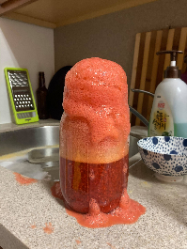
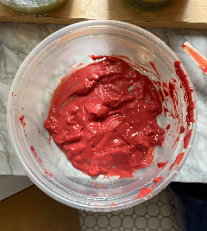
Madder Lake
I had a surprisingly large yield of pigment, which I thought would take forever to dry if left in the coffee filter. I removed it and smeared it over a plastic container, then left it by an open window to dry. This process left me with a beautiful, rosey pigment!
5. Next, add your potash/water solution in small increments. Add it too fast and you’ll have a volcano, like me.
6. After pigment starts to precipitate, filter it through a coffee filter and let it dry.

Slide 25
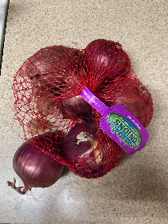
Red Onion Lake
Spoiler alert: my red onion lake turned out green. The original color I was left with, after adding potash solution, was a dark, swampy green. I felt that my experiment failed, so I added vinegar to lower the pH (i.e., make more acidic) as a sort of “why not?” Hail Mary. The color turned into a vivid, bright green! The color was comparable to the green I accidentally made with pomegranate (a process I need to refine). An important observation: I had a huge yield of green pigment from very little onion skin, which is wonderful considering that onions are so affordable and I often have them on hand. Pomegranates, by comparison, are expensive and I only buy them as a treat.
1. Separate the onion skins
2. Boil in water for about an hour, and add equivalent weight of alum as onion skin.
3. Add potash solution. Where did this green come from? I brightened it up with vinegar.

Slide 26
Making Oil Paint
I spent a good amount of time covering the process of making pigments, but how do we turn these into paint?
You don’t need a lot of materials:
Medium of your choice (I used linseed oil, but you can use walnut oil, lavender oil, watercolor mediums like gum arabic, and even egg yolks!)
Muller (there are some DIY options I found on Youtube, but a real one costs at least $30)
Glass board (I used a glass plate since it was cheap, and roughed its surface with sandpaper)
Palette knife
Pigments, of course!

Slide 27
Making Oil Paint
To make oil paint, you essentially need to incorporate your pigment into your medium of choice. Using a circular motion and some pressure, I worked my powdered pigments into linseed oil (of which you need surprisingly little) until I was left with a substance that resembled the oil paint I’m used to buying in tubes.
Some pigments are harder to work with than others, but eventually I was able to get a paint out of nearly all of my samples! The one exception to this was my mica “pigment,” which I suspected might not work from the beginning: using a mortar and pestle, it’s really difficult to grind the mica down past a certain point. Even after levigating, you end up with large flakes of mica that just don’t adhere well to any medium or the paper you put them down on. I’ll try salvaging the mica pigment later on by applying it with glue.

Slide 28
Without further ado, here’s the lineup of my successful pigments! I was able to collect pigment, left to right, from:
Red Onion Skins (with lowered pH)
Pomegranate skin
Madder Roots (from Kremer Pigments)
Purple ochre (from Kremer)
Cochineal (from Kremer)
Mica (without success making paint)
Brick (dark tone)
Brick (light tone)
Yellow Ochre (from Kremer)
Black Glass (obsidian-like stone)

Slide 29
Here’s what everything looks like painted out:
Left: Cochineal, Yellow Ochre, Azurite, foraged “pink stone”
mixed with various binders as noted to the left.
Right:
I made all of my paints using linseed oil as a binding medium.
The Ultramarine blue pictured is actually a synthetic pigment that I bought pre-made from a local art store. I was hoping to find some natural source that could achieve a similar color, but I didn’t have luck with that.

Slide 30
Sources
Recipes for making lakes from Jo Kirby et al, Natural Colorants for Dyeing and Lake Pigments: Practical Recipes and their Historical Sources (Archetype Publications, London, 2014).
Andrew Pheasant JAK Films. Captured by Colour: Introduction to Natural Dyes, 2020. https://www.youtube.com/watch?v=467J41gx2Tk.
BillyNou. HOW TO NATURAL DYE AT HOME WITH AVOCADO | BOTANICAL COLOUR | SHADES OF PINK, 2018. https://www.youtube.com/watch?v=bF-HccgND8Y.
Casa Caribe. AVOCADO SKIN | HOW to NATURAL DYE at HOME | Pink Using Avocado Skins | BOTANICAL COLOURS|CasaCaribe, 2020. https://www.youtube.com/watch?v=bBrCTwM6_V8.
Dana. “Foraging for Pigments from Local Rocks: Making Watercolors, Oils, and Egg Tempera Paint from the Land!” The Druid’s Garden (blog), May 12, 2019. https://druidgarden.wordpress.com/2019/05/12/make-your-own-paints-from-local-rocks-watercolors-oils-and-egg-tempera-from-the-land/.
Great Big Story. This Man Protects the World’s Rarest Colors, 2016. https://www.youtube.com/watch?v=F8aVfqDKx1U.
Jyotsna Pippal. “How to Make Natural Pigments from Foraged Raw Resources.” Lost in Colours (blog), April 14, 2020. https://www.lostincolours.com/foraging-for-pigments-from-local-rocks/.
Jyotsna Pippal. How to Forage for Natural Pigments!, 2020. https://www.youtube.com/watch?v=-TTEjbK-YhQ.
———. How to Make Egg Shell White Watercolour Paint, 2021. https://www.youtube.com/watch?v=F0t6mQsffZA.
———. How to Make Natural Pigments from Rocks!, 2020. https://www.youtube.com/watch?v=RrXd40xk7Sg.
Kales Brown. How to Make Pigment from Scratch | Flowers, Shells, and Rocks, 2020. https://www.youtube.com/watch?v=25Fg-HodpzA.
Lindsey Foust. How to Tie Dye with Avocados // Easy Natural Dye Tutorial, 2020. https://www.youtube.com/watch?v=M06DKQsYKFc.
Margaret Byrd: Color Quest. HOW TO USE POMEGRANATE SKIN AS A TANNIN MORDANT FOR NATURAL DYE | ORGANIC COLOR | YELLOW | COTTON, 2020. https://www.youtube.com/watch?v=YGPWRS5VTE4.
Nada Makes. All My Homemade Pigments and Paints After a Couple of Years (Organic, Inorganic, and Synthetic), 2020. https://www.youtube.com/watch?v=9MTGbl8vg94.
“Nature Lab - Natural Dyes and Pigments.” Accessed June 14, 2021. //naturelab.risd.edu/discover/natural-dyes-and-pigments/.
Noa Leibson. Creating Madder Red Lake Pigment, 2021. https://www.youtube.com/watch?v=e_eRBEcgLuw.
WILD PIGMENT PROJECT. “Reciprocal Foraging.” Accessed June 14, 2021. https://wildpigmentproject.org/reciprocal-foraging.
SquiggleMom. Harvesting Madder: A Natural Red Plant Dye, 2014. https://www.youtube.com/watch?v=jkgJpibkSVU.
The Alchemical Arts. Genuine Madder Lake Pigment Extraction., 2019. https://www.youtube.com/watch?v=_YVO2Dr8gD8.
———. How to Make Your Own Lake Pigments: Pomegranate Yellow, 2020. https://www.youtube.com/watch?v=BqlmghM1CCY.
———. Ochre Pigments | Part 1: Preparation of Earth Colours, 2019. https://www.youtube.com/watch?v=LKGsQxv72AA.
The Green Hippopotamus. How to Make Lake Pigment from Madder Root Dye?, 2019. https://www.youtube.com/watch?v=A1UVRJGiZJ8.
The Novium Museum. Creating Pigment Paints with Caroline Nicolay of Pario Gallico, 2020. https://www.youtube.com/watch?v=yYi2JEcp07w.
Trillium: Wild Edibles. Finding Natural Paint For Primitive Bush Craft And How To Use It, 2017. https://www.youtube.com/watch?v=3V4LcU3mlE8.

