Slide 1
Dyeing with Cochineal

Slide 2
What is an experiment?
What is experience?
Canva
Notes:
Where does it take place?

Slide 3
Procedure
Curiosity
Testing
Sharing results

Slide 4
Part 2
Dyeing

Slide 5
Mordant
Mordants are metals that connect the textile fiber and the dye
They strengthen and prolong the colors by keeping them from fading in response to harsh physical conditions.
Alum - potassium alum (KAl ₂·12 H ₂O)

Slide 7
Mordant
Measure out water into pot
1g Textile (weight of fiber - WOF) : 0.2g mordant (alum) : 50g water
Add alum and stir
Place beaker onto hot plate and turn on to medium-low
Stir to dissolve alum in the water
Add textiles when alum solution reaches 70º C
Heat the textiles for 30 minutes at 80-90º C, stirring occasionally to ensure homogenous absorption
Remove textiles, rinsing them thoroughly in cold water

Slide 8
Cochineal
Art History and Environmental Biology

Slide 9
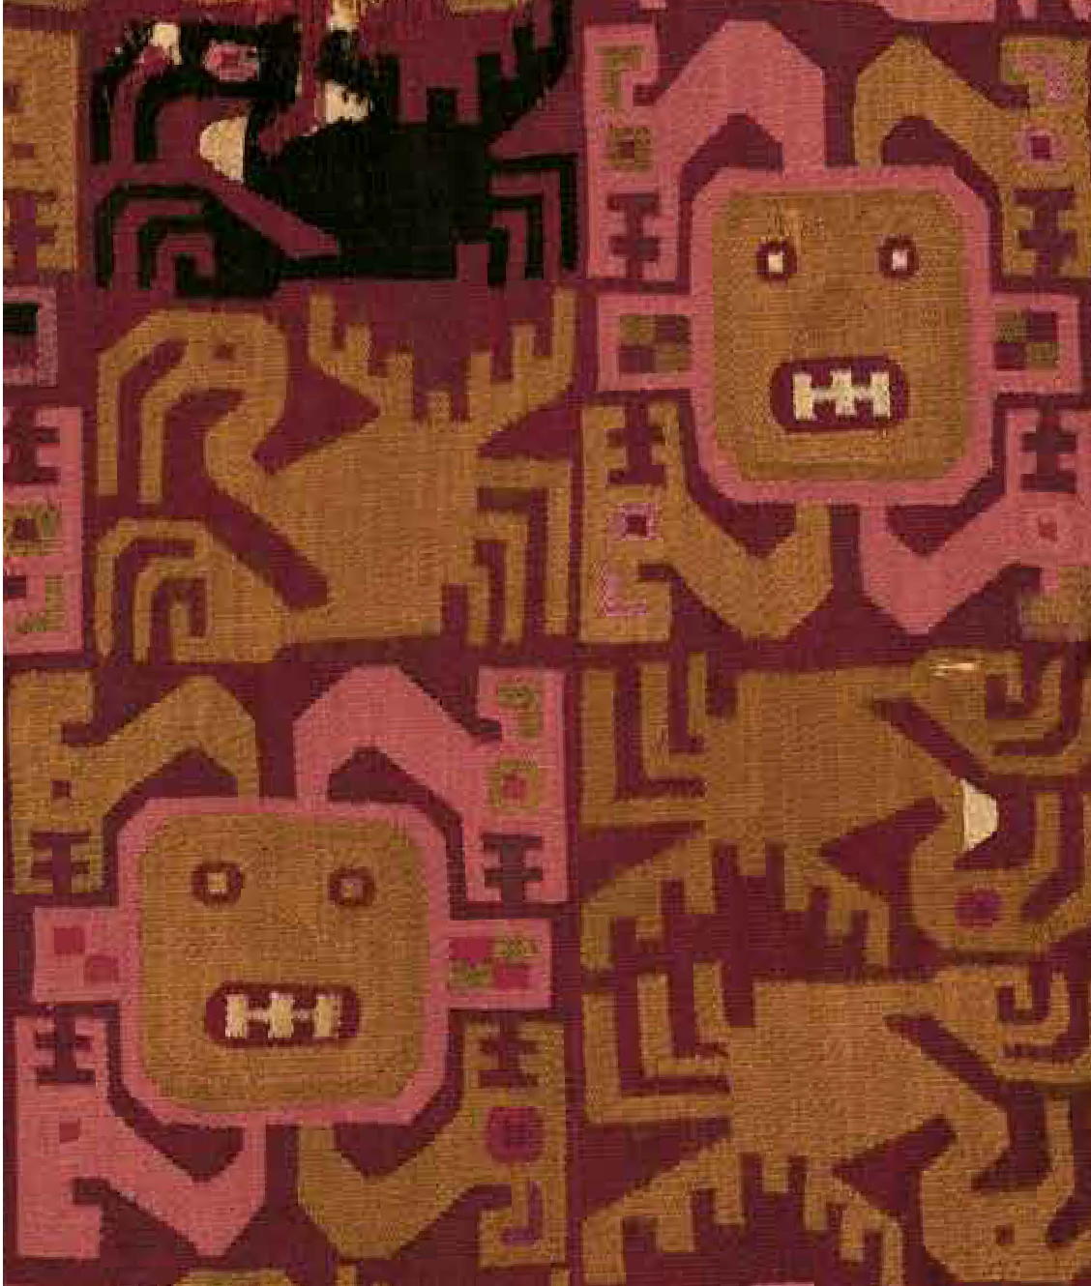
Textile fragment with faces and birds. Peru, 4th-6th century

Slide 10
A bit of history…
Cochineal has been used as a dye and pigment since ancient times
“In our 21st-century world, colour lacks history; we are mostly unaware of where the colours we inhabit come from… [We ought to] rethink perfect red as an assemblage of plants, insects, meteorological conditions, qualities of soil and climates, and temperaments, of places and of people.” -Miruna Achim, historian

Slide 11
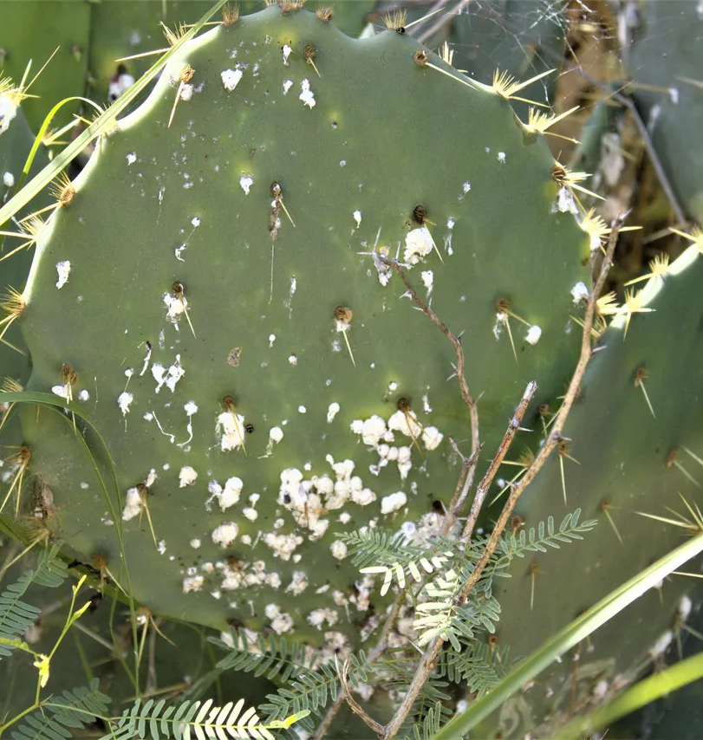
Cochineal
Dactylopius coccus is a species of insect native to parts of Mexico and South America.
It is a parasite that lives on the prickly pear cactus
Its nutrition comes from sugars inside the plant.
Once it latches onto the cactus, it cannot
move again

Slide 12
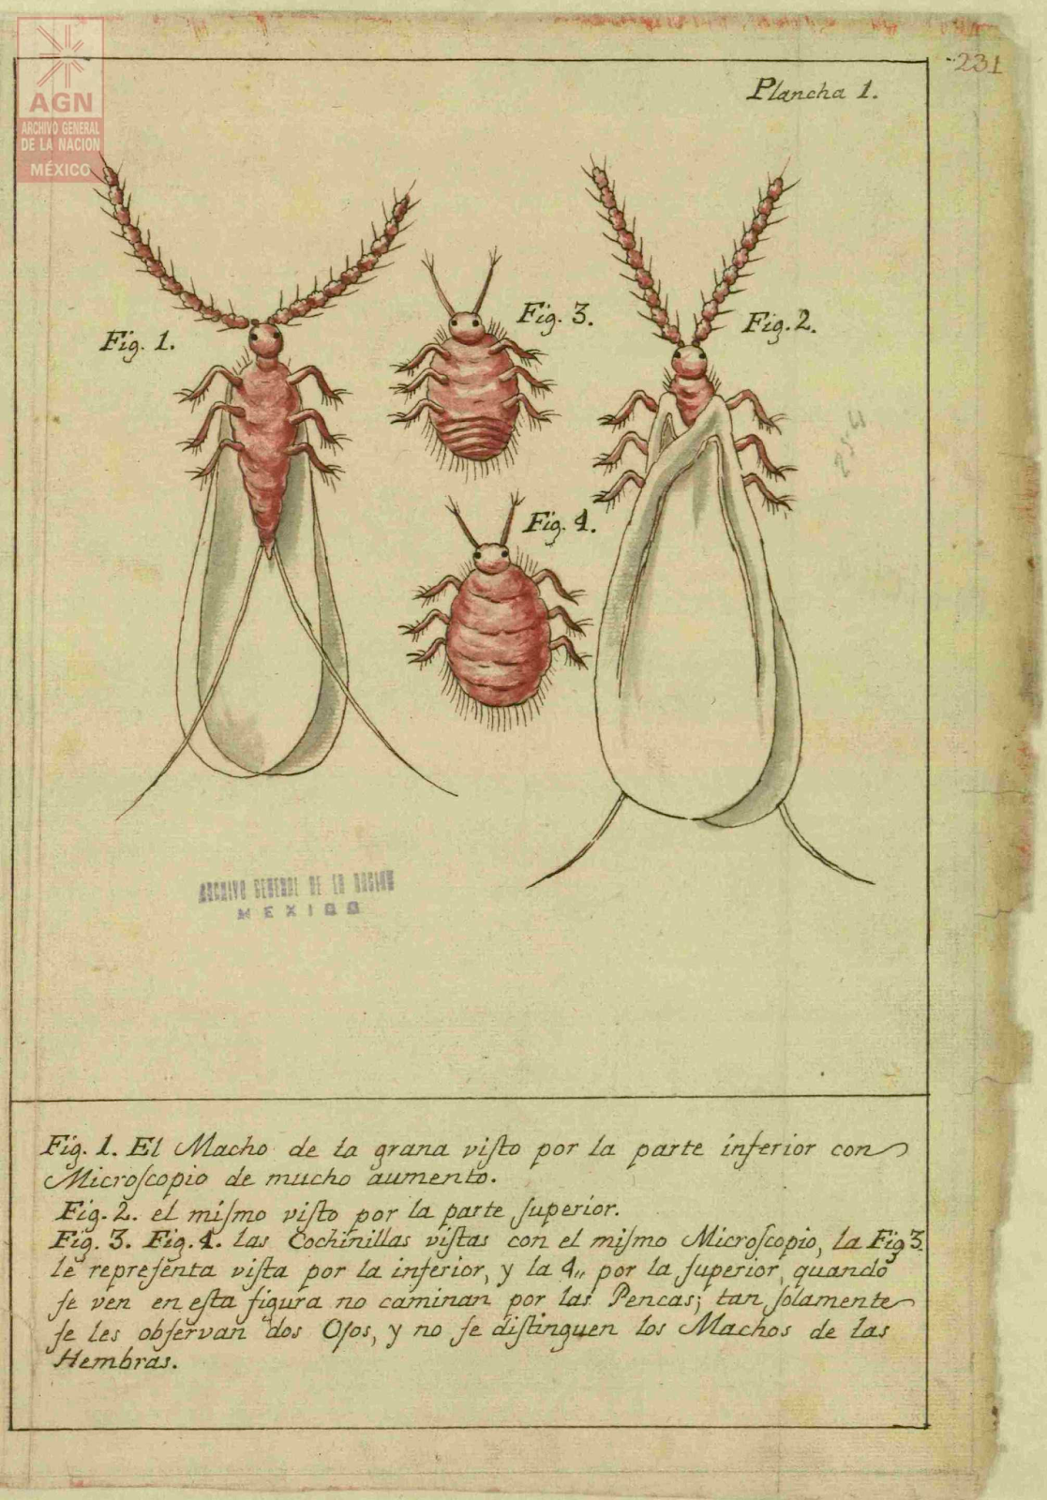
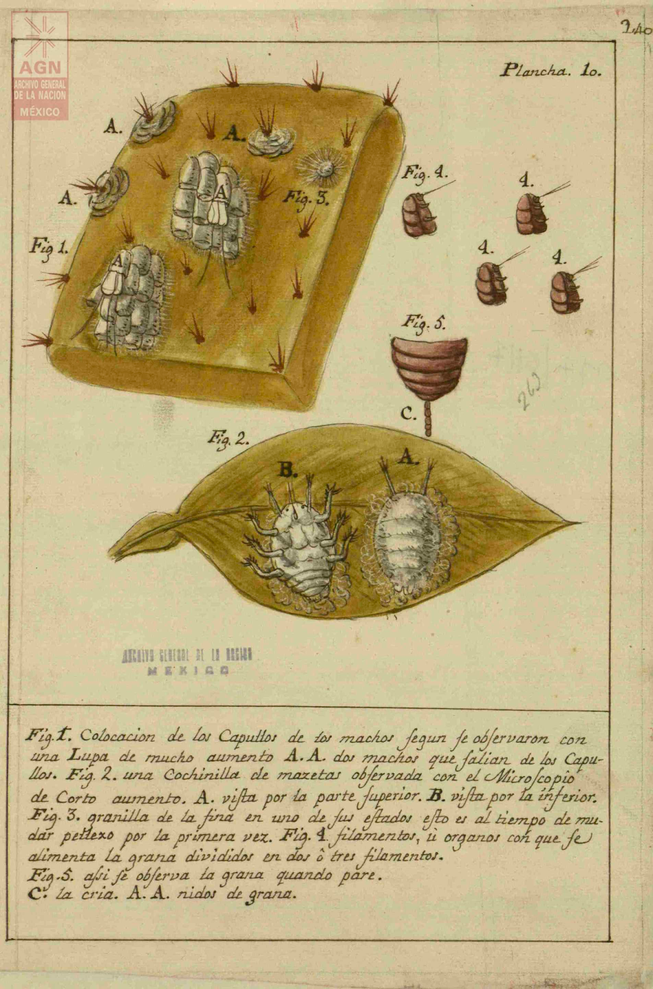
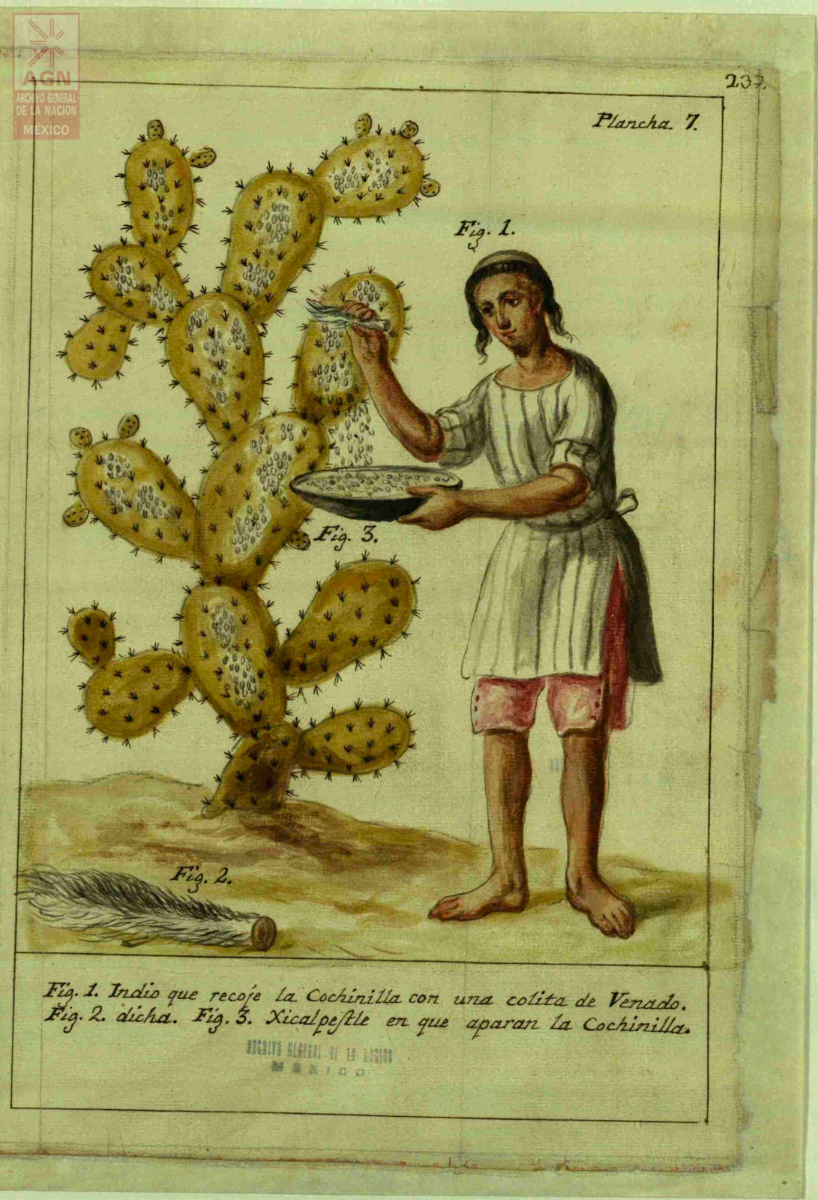
Cochineal
José Antonio de Alzate y Ramírez, a Spanish priest, published Memoria sobre la naturaleza, cultivo y beneficio de la grana (Treatise on the Nature, Cultivation and the Processing of Cochineal) in 1777

Slide 13
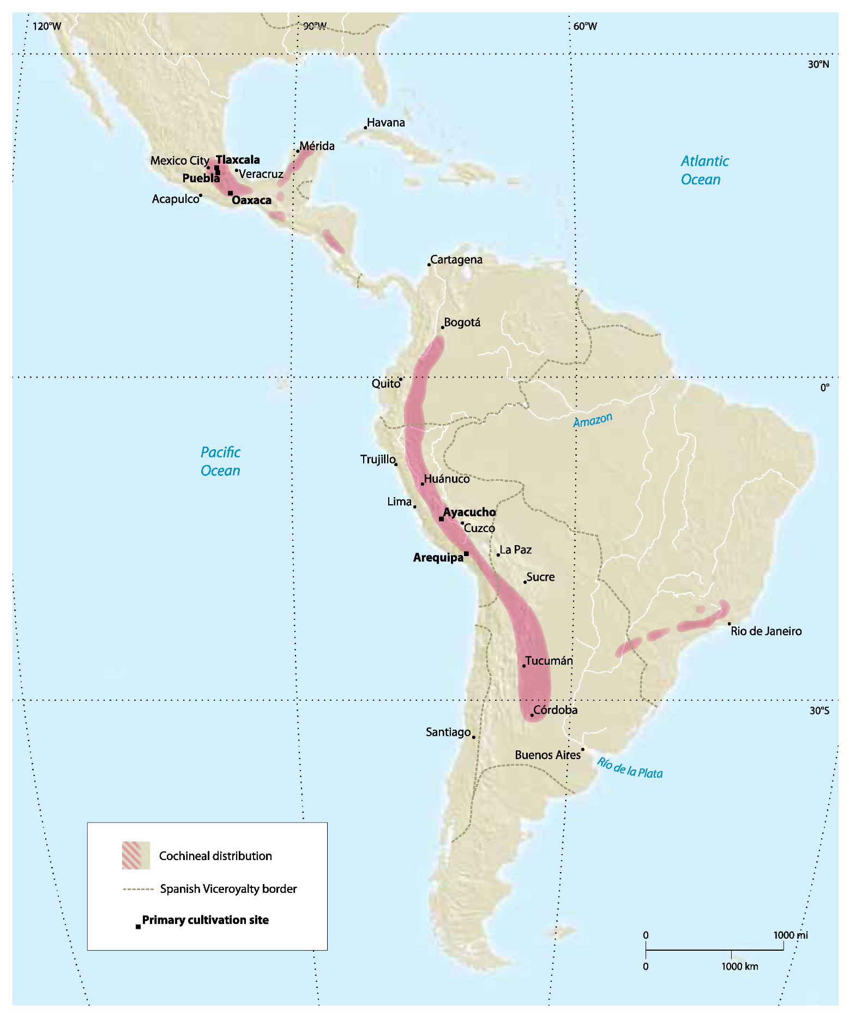
Cochineal cultivation from the 16th-19th centuries, from Cochineal Red: The Art History of a Color by Elena Phipps

Slide 14
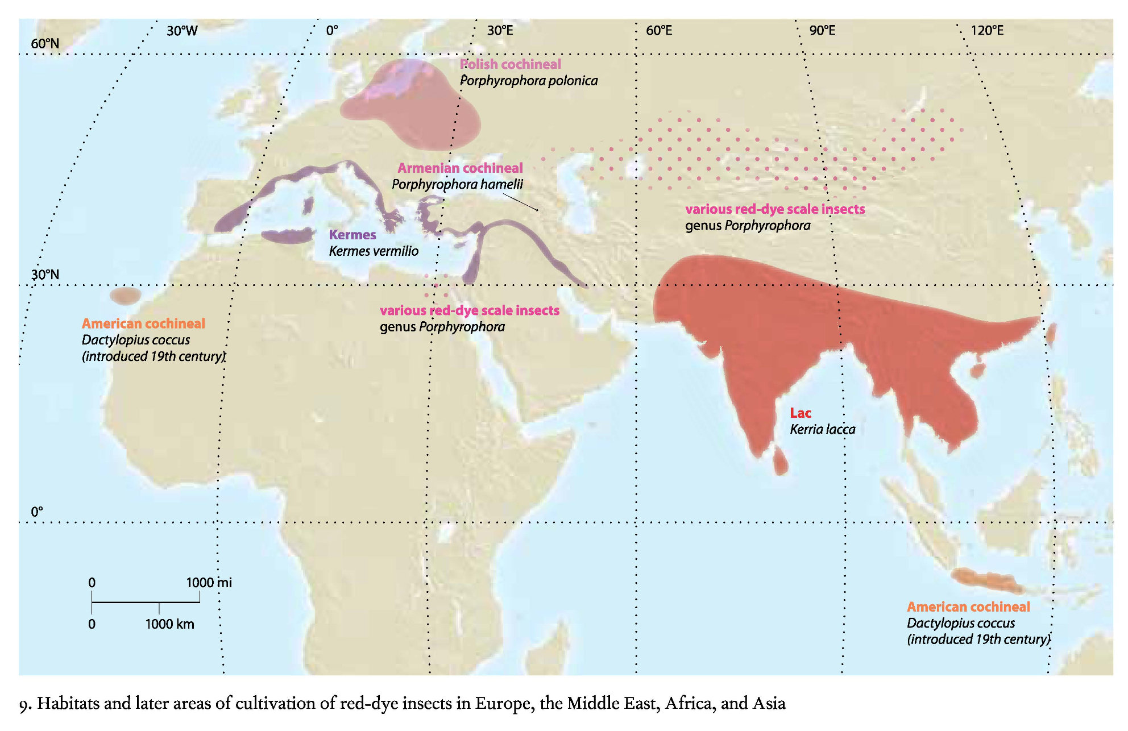

Slide 15
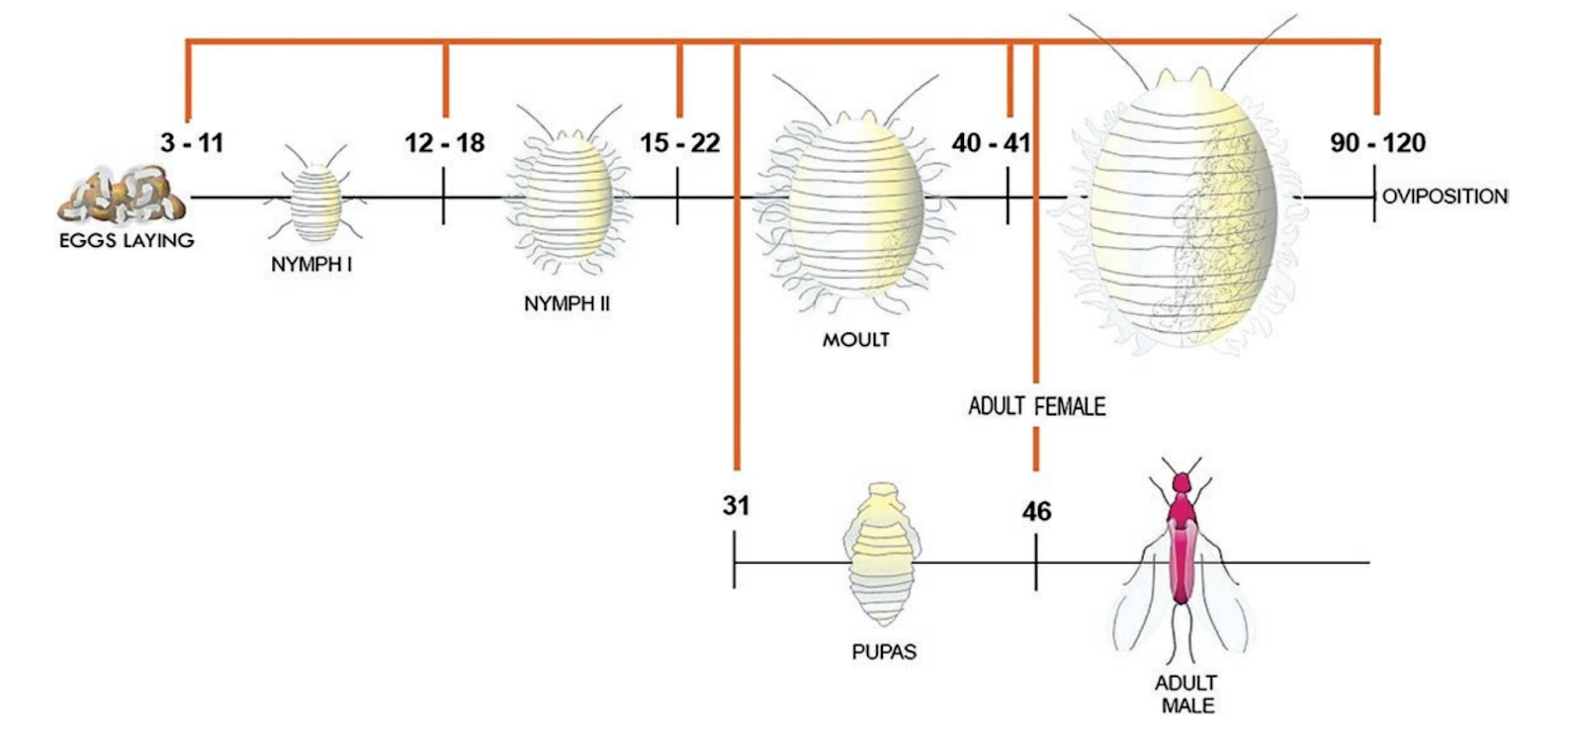
Life Cycle
Image created by Francisco Javier Roque-Rodríguez.
How does this life cycle compare to other insects you know about?
Notes:
Its life cycle is divided into three main stages: egg, nymph, and adult. “After hatching from an egg the female crawlers commonly walk upward on plants where they become dispersed by the wind. Male crawlers tend to remain on the plant where they hatched. Males commonly disperse when they mature into winged adults.”

Slide 16
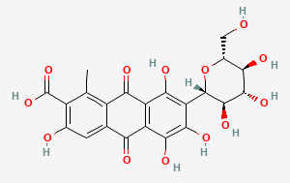
Its weapon:
Carminic Acid C₂₂H₂₀O₁₃

Slide 17
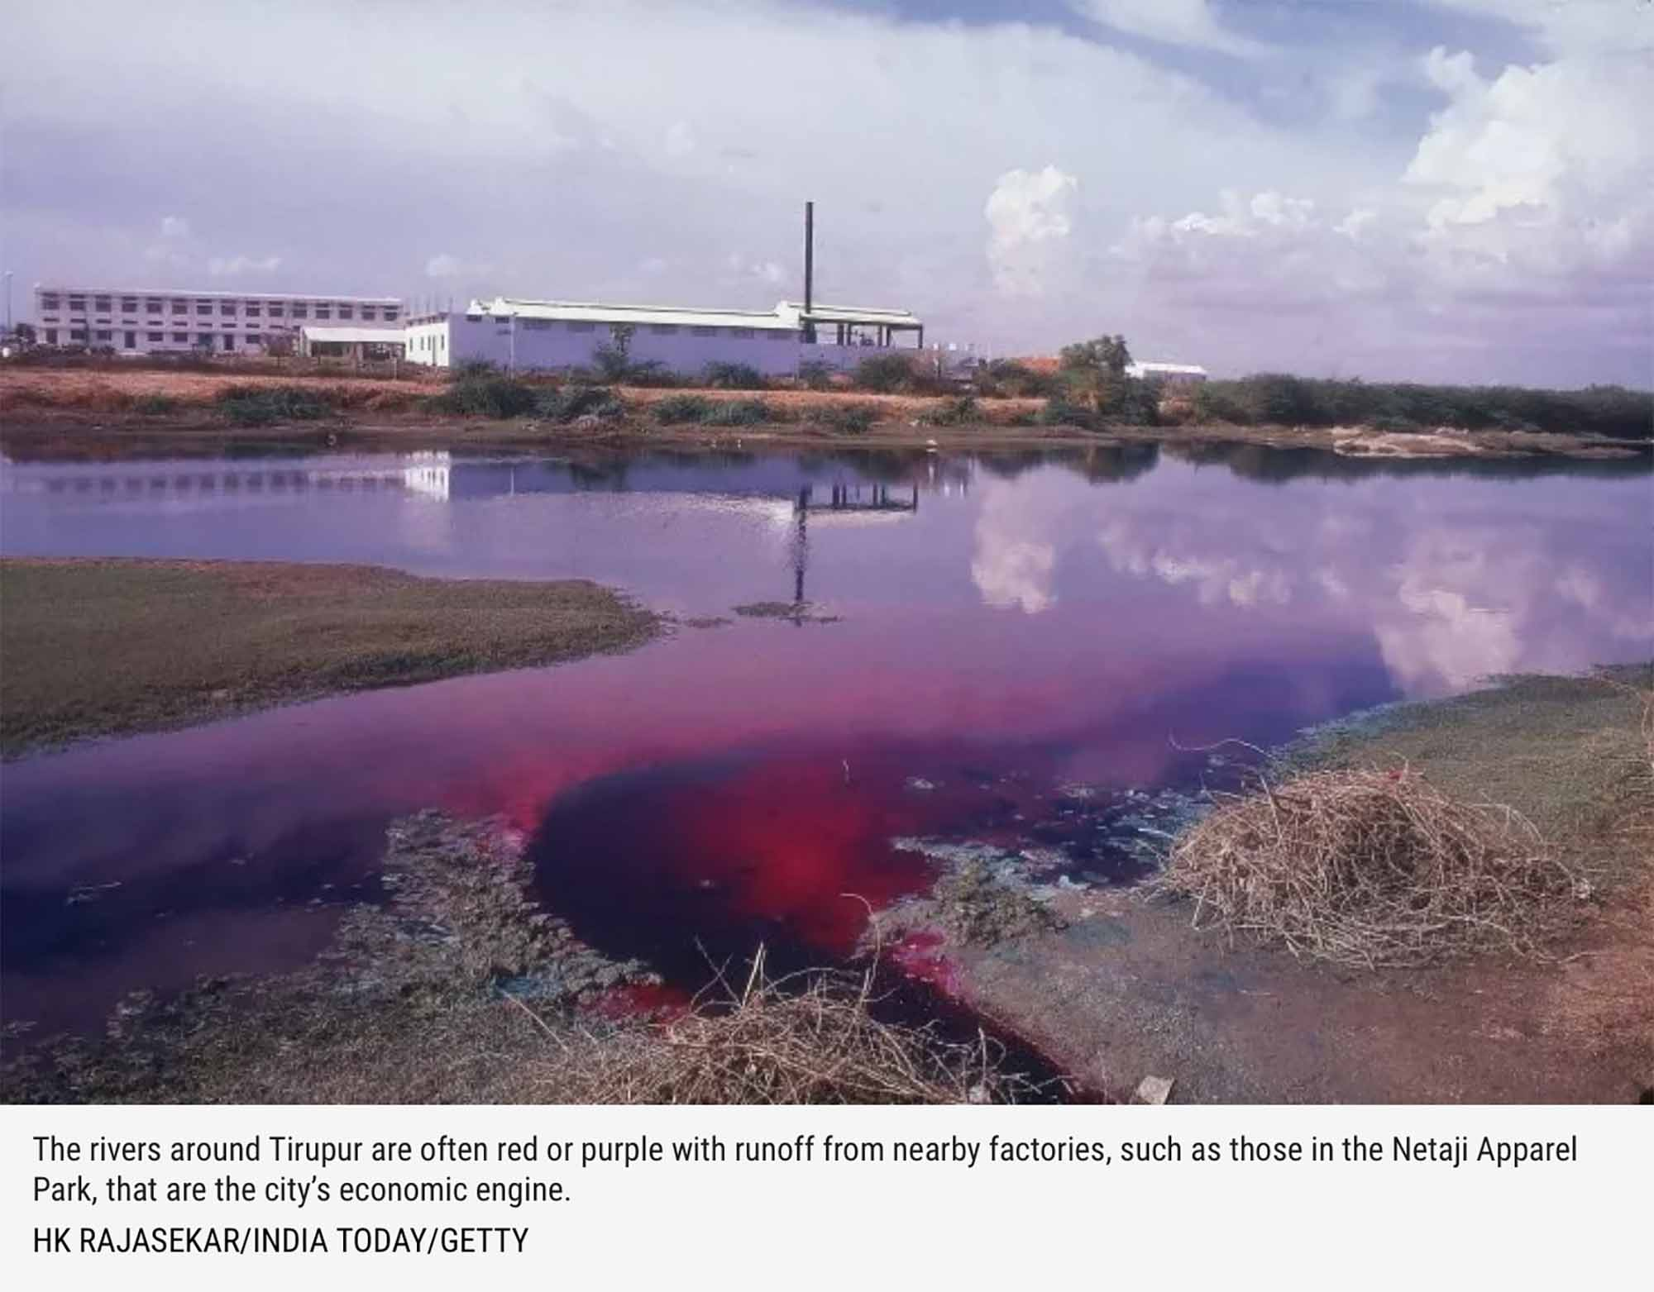
Synthetic dyes
Google Slides
Canva
Notes:
Beginning in the nineteenth century, most textiles have been processed with synthetic dyes. These create adverse environmental and human health conditions, especially in the developing countries that host manufacturing facilities.

Slide 18
Extract dye
​​Using mortar and pestle, crush dyestuffs to a fine powder or into small pieces
Measure out water and pour into pot
Add dyestuffs to coffee filter, close with a rubber band, add bag to water
Place pot on hot plate, at medium-low
Heat the bath (without the textiles) at 80-90 °C for 30 minutes, stirring occasionally
After 30 minutes, remove dyestuffs in drawstring bag

Slide 19
Dye bath
Add textiles to the dye bath
Heat textiles at 80-90 °C for 30 min, stirring occasionally to ensure homogeneous dyeing
After 30 minutes, remove the textiles from the bath
Wash textiles with clean water to remove any dye that has not bound to them
When the water runs clear over the textiles and no color comes off the textiles, wring out excess water

Slide 20
Resources
When does a natural resource become a material?
What is the importance of understanding where materials come from?

Slide 21
Reflection
Canva

